Slide 1
Social Wall 2.0
Team Member: Steve Noel
Role: Scrum Master, lead Developer
CIS-4911 –Spring 2015
Introductory Video

Slide 2
Problem
Users do not have a convenient and effective way of display their account images in a slideshow format, on large screens
Users do not have the control to dynamically modify the display of their images on the large screen.

Slide 3
Current Systems
Require users to use applications such as Microsoft's PowerPoint to manually create image sideshows.
Require users to connect their computers to the desired display screen.
Require users to use services from companies such as Tintup that can cost upwards of $1000 dollars/month.
Require users to use mobile applications such as AllCast that have a limited source of images and offer few customization features.

Slide 4
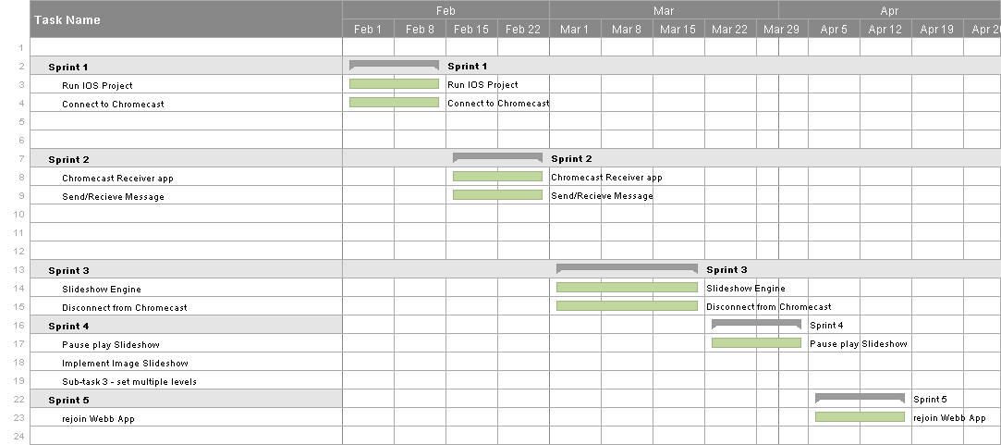
Project Schedule

Slide 5
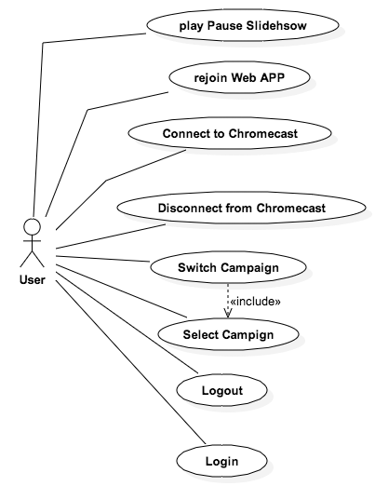
Use Case Diagram

Slide 6
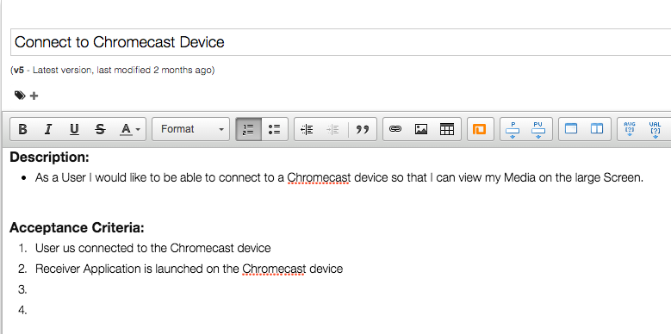
User Stories
Title : Connect to Chromecast Device
Description: As a user I would like to be able to connect to a Chromecast device

Slide 7
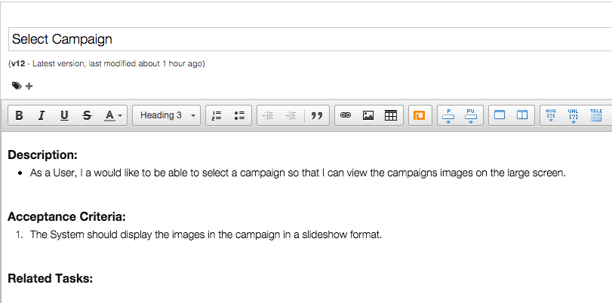
User Stories
Title : Connect to Chromecast Device
Description: As a user I would like to be able to connect to a Chromecast device

Slide 8
Use Cases
Use Case: Connect to Chrome cast
Actor: User
Description:
1. The use case begins when the user presses the “Connect to Chrome cast“ button.
2. The system then shows a list of Chrome cast devices on the network.
3. The user then selects a device from the list of devices.
4. The system then hides the list view and establishes a connection with the selected device.
5. The use case ends when the system launches the custom receiver application on the Chrome cast device and establishes a web App Session with the running application.

Slide 9
Use Cases
Use Case: Select Campaign
Actor: User
Description:
1. The use case begins when the user selects a campaign from the campaign list.
2. The system then sets the campaign as the active campaign.
3. The system then sends a JSON message to the custom receiver application.
4. The system then receives the message and parses the message.
5. The system identifies the message and fetches the necessary data.
6. The use case ends when the system creates and displays a image slideshow object with the fetched data.

Slide 10
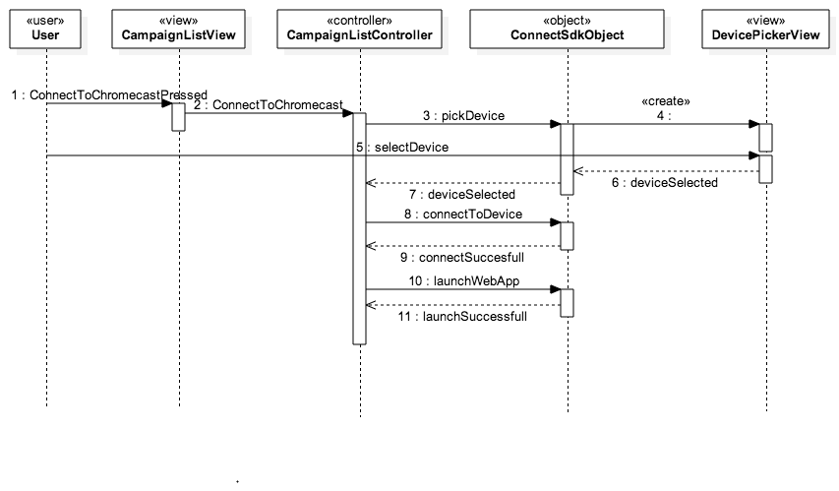
Sequence Diagrams
Connect to Chromecast Sequence Diagram

Slide 11
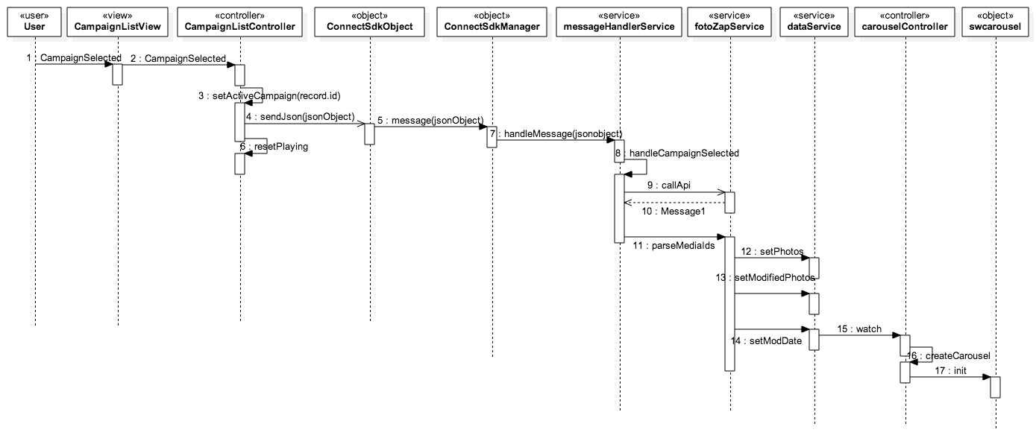
Sequence Diagrams
Select Campaign Sequence Diagram

Slide 12
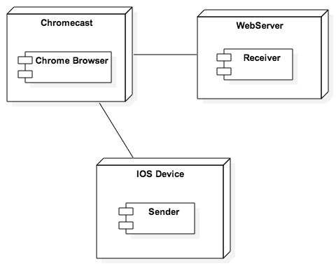
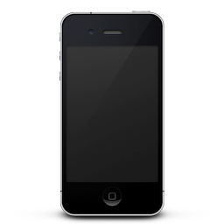

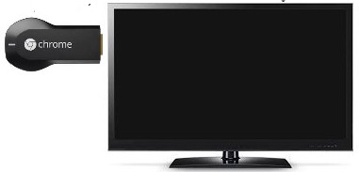
System Decomposition
Architectures:
Server-Client
Centralized
High Accessibility
Model-View-Controller
High flexibility and
reusability
Google Cast
Console
Google Cast
Console
Google Cast
Console
Google Cast
Console
Sender
Google Cast
Console
Sender
Google Cast
Console
Sender
Google Cast
Console
Receiver
Sender
Google Cast
Console
Receiver
Sender
Receiver
Sender
Receiver
Sender
Receiver
Sender
Receiver
Receiver
Receiver
Socket
Socket
Socket
Socket
Socket
Socket
Socket
Socket

Slide 13
System Deployment
Hardware
Mac Computer running OSX or higher
Chromecast device
HD TV
Software
Github
Mingle Project Management Tool
Xcode IDE
ConnectSdk Framework
Cordova
Sencha Touch Framework
AngularJS Framework

Slide 14
Persistent Data Design
No persistent data is stored in the system.
Data is constantly retrieved from the Web.

Slide 15
Security/Privacy
TLS SHA-1 Encryption
Base64 data Encoding

Slide 16
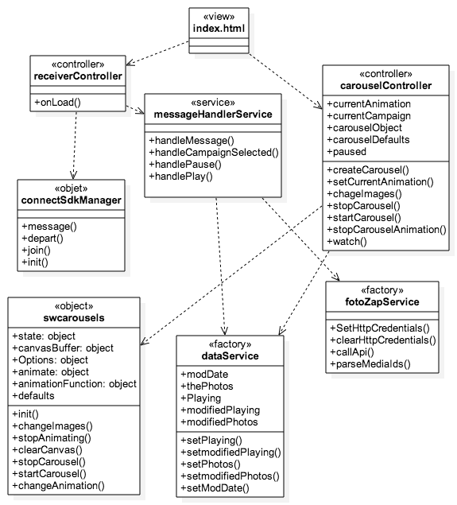
Minimal Class Diagram
Receiver Class Diagram

Slide 17
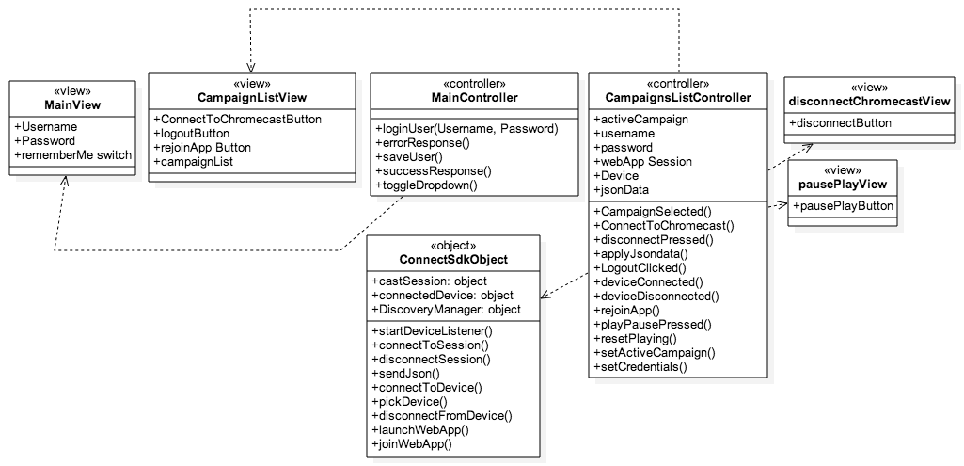
Minimal Class Diagram
Sender Class Diagram

Slide 18
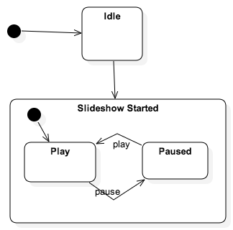
State Machine: Carousel Controller

Slide 19
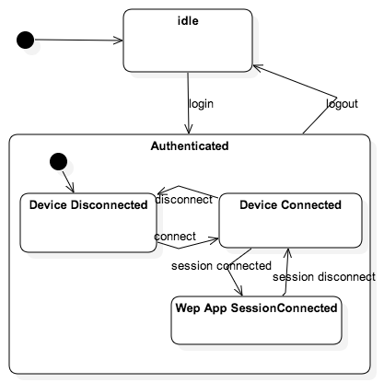
State Machine: Campaign List Controller

Slide 20
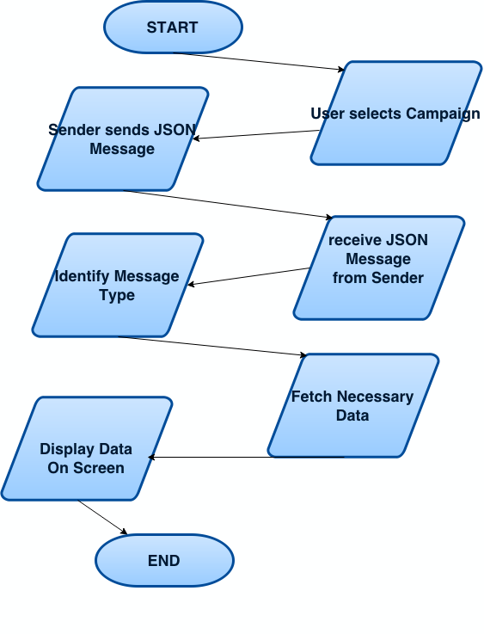
Main Algorithm

Slide 21
Test Cases
Use Case : Connect to Chromecast Sunny Day
Purpose:
Ensure that the user can connect to the Chrome cast device running.
Test Setup Environment:
Test run using actual IOS Device and a running Chromecast
Test Input(s):
User presses the Connect to Chrome cast device button.
User selects the Chrome cast device to connect to.
Expected Output(s):
User is connected to the Chrome cast device and has a launched the receiver app on the device.
Actual Output(s):
The device is connected to the Chrome cast device and has launched the receiver application. (TEST PASSED)

Slide 22
Test Cases
Use Case: Connect to Chromecast Rainy Day
Purpose:
Ensure that a user cannot connect to a device that is not a Chromecast device.
Test Setup Environment:
Test run on the IOS simulator, with a APPLE TV device as the device to connect to.
Test Input(s):
User presses the Connect to Chrome cast button.
User selects a Device that is a Apple TV device.
Expected Output(s):
An error message saying that the device selected by the user is not supported by the system.
Actual Output(s):
App displays the following error: Error:Invalid Device. (TEST PASSED)

Slide 23
Test Cases
Use Case : Select Campaign Sunny Day
Purpose:
Ensure that when a message is received the receiver application displays the data.
Test Setup Environment:
Test run with Karma Test Runner and Jasmine, on Google Chrome browser.
Test Input(s):
Test simulates message by proving a stubbed message object and API response.
Expected Output(s):
Carousel object should holds the images from the message and is displaying them on the screen.
Actual Output(s):
Image slideshow displayed (TEST PASSED)

Slide 24
Test Cases
Use Case : Select Campaign Rainy Day
Purpose:
Selects a Campaign the receiver application is not connected to the sender is not received by the system.
Test Setup Environment:
Test setup using the actual mobile device with the Chrome cast device disconnected to screen.
Test Input(s):
User selects a Campaign from the Campaign List.
Expected Output(s):
System should disregard the message.
Actual Output(s):
Message not received.(TEST PASSED)

Slide 25
Demo!!!

Slide 26
Thank You.

